Slide 1
CAS Intro Meeting

Slide 2
Agenda
Team Builder led by Mr. Braman
CAS: what is it?
Managebac and how to use it

Slide 3
What is CAS?
Experiential learning component of the Diploma Program
Makes sure you are counterbalancing the academic pressures of school with creative, active, and service activities
Should be challenging and enjoyable, a personal journey of self-discovery for you

Slide 4
3 Strands of CAS
Creativity: arts, digital design, writing, film, culinary arts, crafts, composition and other activities involving creative thinking (robotics, JSA, etc.)
Activity: physical exertion contributing to a healthy lifestyle (on your own or with a team)
Service: engagement with the community (in school or outside of school) in response to an authentic need
Some activities will involve more than one strand.

Slide 5
ALL proposed activities must meet these 4 criteria….
Fits within one of the 3 strands
Is based on a personal interest, skill, talent, or opportunity for growth
Provides opportunities to develop the attributes of the IB Learner Profile: Inquirer, Knowledgeable, Thinker, Communicator, Principled, Open-Minded, Caring, Risk-Taking, Balanced, Reflective
Is not used or included in Diploma course requirements (so, is extracurricular or related to a non-IB diploma class you are taking)

Slide 6
Duration of CAS
Begins at the beginning of this school year
Continues on a weekly basis during the school year until April of senior year
May be done in the summer between junior and senior year, but this is optional

Slide 7
Balance of Strands
Students should be involved in CAS on a weekly basis over the course of the semester
Students should complete at least one CAS experience each semester for each strand: Creativity, Activity, and Service
Example: Student plays soccer for a team on a weekly basis; Student volunteers for Mountains to Sound Greenway one Saturday; Student is involved on a regular basis in an Indian dance group

Slide 8
What do You Need To Do this Year?
Plan, Participate in and document your CAS for Semester 1
Plan your CAS Project. Complete the CAS Project Planning form and upload it to Managebac
Plan, Participate in and document your CAS for Semester 2
Participate in 2 CAS Check-ins during Pre-TOK, one in the fall and one in the spring

Slide 9
7 Learning Outcomes
Identify own strengths, develop areas for growth
Demonstrate that challenges have been undertaken, developing new skills in the process
Demonstrate how to initiate and plan a CAS experience
Demonstrate the skills and recognize the benefits of working collaboratively
Show commitment to and perseverance in CAS experiences
Demonstrate engagement with issues of global significance
Recognize and consider the ethics of choices and actions
Students must demonstrate they have met all 7 of these at least once over the two years in the course of CAS.

Slide 10
CAS Stages
1. Investigation
2. Preparation
3. Action
4. Reflection
5. Demonstration
A singular CAS experience may begin with stage 1, 2 or 3. A CAS project should involve stages 1-3.
All students will accomplish stages 4 and 5 through their Managebac portfolio.

Slide 11
Role of the CAS Advisor
Provide personal advice and support to you…
Approve your activities on Managebac or respond and give you feedback about what would be an appropriate activity or how to complete an entry correctly
Meet with you at CAS check-in sessions, twice during junior year and once during senior year

Slide 12
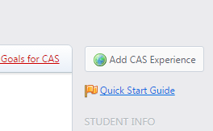
For Each Activity… Step One:
Plan: Add your CAS activity on Managebac – Click on Add CAS Experience in the upper right hand corner

Slide 13
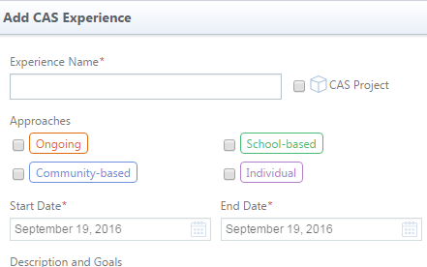
Adding a CAS Experience
Give the experience a name
If it is a CAS Project, check the box
Choose an Approach
Put in the start and end dates (make your best guess…you can edit this later)

Slide 14
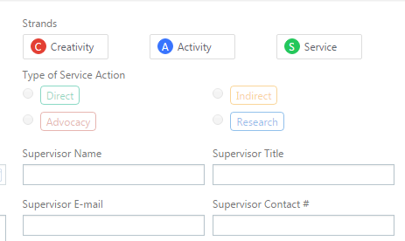
Adding a CAS Experience
Choose a Strand
Add your Supervisor (must be an adult.) If activity has no official supervisor, you may list a parent. You don’t need a Title or Contact # but you will need an email. If you don’t know it, remember to go back and add it later.

Slide 15
Adding a CAS Experience
Type in a thoughtful description of the activity (including who, what, where, when, why)4-5 sentences minimum. Identify your goals, which will be related to the 2 or 3 learning outcomes (see next slide) you want to meet).

Slide 16
Adding a CAS Experience
Select your CAS Learning Outcomes (2-3 per activity, not more)
As a reminder, here are full descriptions:
1. Identify own strengths, develop areas for growth
2. Demonstrate that challenges have been undertaken, developing new skills in the process
3. Demonstrate how to initiate and plan a CAS experience
4. Demonstrate the skills and recognize the benefits of working collaboratively
5. Show commitment to and perseverance in CAS experiences
6. Demonstrate engagement with issues of global significance
7. Recognize and consider the ethics of choices and actions

Slide 17
Semester Long Activities
Add at the beginning of the activity (not each week)
Add evidence and write reflections when you are done with the activity
If you plan to use the same activity the following semester, call the activity, for example: Semester 1 Rowing. The next semester, call the activity: Semester 2 Rowing.
Your goals for the activity should change each semester & your reflections should show how you have developed over time

Slide 18
Step Two:
Do
Participate in the activity.
Collect evidence (photos, videos, flyers, artifacts, web page links, etc.)

Slide 19
Step Three:
Reflect.
Complete your reflections shortly after you complete the activity
For a longer activity or CAS project, complete reflections at the end of each semester
Your reflections will be tied directly to the learning outcomes you selected
Write one paragraph per learning outcome

Slide 20
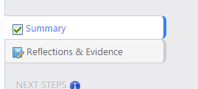
Adding Reflections & Evidence
Click on “Reflections & Evidence” on the right hand side of the activity

Slide 21
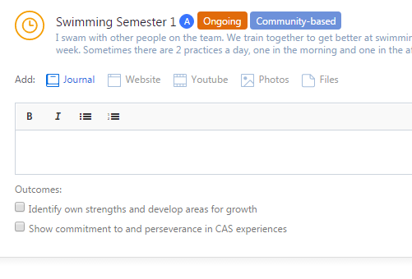
Adding Reflections & Evidence
You can add photos, web page links, videos, etc.
You will also need to write one fully developed paragraph per learning outcome you chose for the activity
See the CAS Handbook for a sample reflection

Slide 22
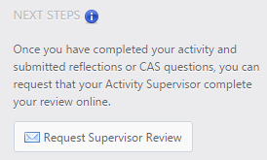
Step Four:
Request Supervisor Review
Once your supervisor (not your advisor!) has completed the review, the activity is complete
Your supervisor is the adult (swim coach, NHS advisor) who supervised the experience.
NOTE: if you request the supervisor review before writing the reflection, the activity will be locked, and you will need to ask your CAS Advisor to unlock it for you.

Slide 23
For All Activities
Document your activities.
A minimum of 2 pieces of evidence for each activity. Evidence could be….
Photos
Video
Flyer
Chart
Map
Document
Etc.
For activities like jogging or practicing piano, keep a log of time spent and what was done during the time, with each entry in the log signed by a parent. This can be uploaded as evidence.

Slide 24
Ongoing…
Communication between you and your CAS Advisor takes place through Managebac (in the Notes section)
When your Advisor contacts you, get back to them as soon as possible
Check your email!!!

Slide 25
The CAS Project
Students must complete at least one project
Purpose is to ensure participation in sustained collaboration
involving teamwork
In one strand OR combining strands
With a duration of at least one month
Example: A group of students plans and stages a basketball tournament for the local community.

Slide 26
The 3 Strands
Creativity
Any activity involving creative thinking
Action
Physical Fitness related
Service
Must be unpaid and voluntary.
Good if you are taking on some responsibility.
Must have a learning benefit for you.

Slide 27
Creativity Activities could include…
Youth symphony
Club officer
Student council
Youth advisory board
Robotics club
DECA
JSA
Model UN
Columnist for Issaquah Press
Painting, writing, photography, cooking, etc.

Slide 28
Action Activities could include…
Sports team
Hiking
Yoga
Training for a race
Snowboarding
Taekwondo
Cycling
Dance
Working out at the gym

Slide 29
Service Activities could include…
Mountains to Sound Greenway
NHS Tutoring
Key Club Activities
Hospital Volunteer
Relay for Life
Link Crew
Club or class officer
Salmon Days
Earthcorps

Slide 30
CAS Handbook
Goal
Managebac
CAS Vocab
CAS Protocol: the Steps
A summary of responsibilities

Slide 31
Questions?

